Slide 1
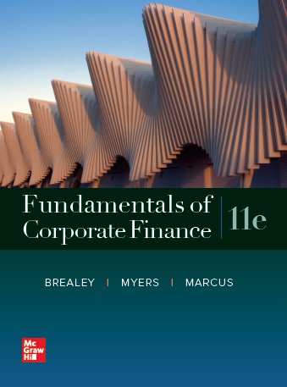
Fundamentals of Corporate Finance, 11th Edition
CHAPTER 6: Valuing Bonds
© McGraw Hill LLC. All rights reserved. No reproduction or distribution without the prior written consent of McGraw Hill LLC.

Slide 2
The Yield Curve (1 of 2)
Term Structure of Interest Rates
A listing of bond maturity dates and the interest rates that correspond with each date
Yield Curve
Plot of relationship between bond yields to maturity and time to maturity (generally upward sloping because longer maturities pose greater Interest Rate Risk)
Notes:
26

Slide 3
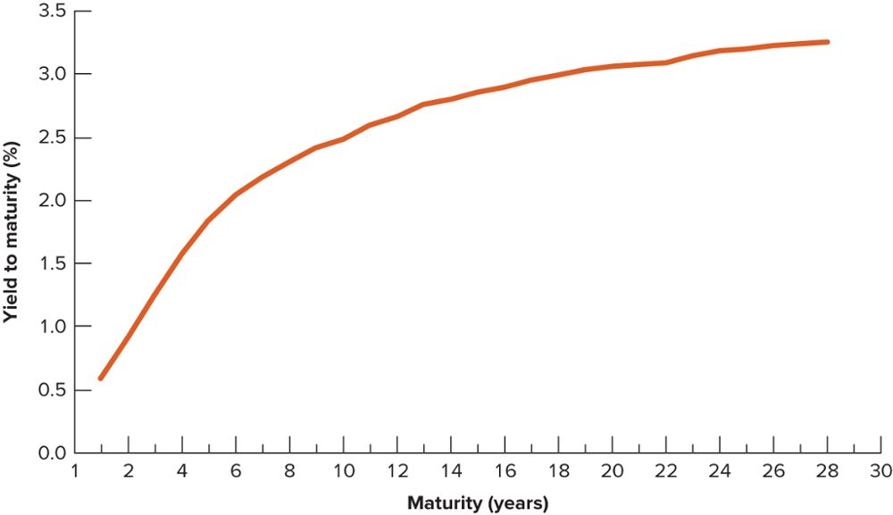
The Yield Curve (2 of 2)
Treasury strips are bonds that make a single payment. The yields on Treasury strips in November 2015 show that investors received a higher yield on longer term bonds.

Slide 4
Interest Rate Risk and Yields
Example using Yield Curve
1 Year Yield To Maturity (r) 0.5%
5 Year YTM 1.5%
10 Year YTM 2.4%
All are Treasury Securities, so….
the only difference in risk is the maturity
remember, assumption is no Default Risk
Notes:
17

Slide 5
Interest Rate Risk and Yields
Example using Yield Curve
1 Year YTM (r) 0.5%
5 Year YTM 1.5%
10 Year YTM 2.4%
Our model will call the 1 Year Yield
the Risk-Free Rate (r_{f})
Notes:
17

Slide 6
Interest Rate Risk and Yields
Example using Yield Curve
1 Year YTM (r) 0.5%
5 Year YTM 1.5%
10 Year YTM 2.4%
5 Year Maturity Risk Premium (r_{mp}):
1.5% - 0.5% = 1%
Market needs additional 1% to go 5 years
Notes:
17

Slide 7
Interest Rate Risk and Yields
Example using Yield Curve
1 Year YTM (r) 0.5%
5 Year YTM 1.5%
10 Year YTM 2.4%
10 Year Maturity Risk Premium (r_{mp}):
2.4% - 0.5% = 1.9%
Market needs additional 1.9% to go 10 years
Notes:
17

Slide 8
Interest Rate Risk and Yields
Yield Curve
1 Year YTM (r) 0.5% r_{mp} 0.00%
5 Year YTM 1.5% r_{mp} 1.00%
10 Year YTM 2.4% r_{mp} 1.90%
Greater the maturity, greater the Interest Rate Risk, higher the risk premium
Upward sloping Yield Curve
Notes:
17

Slide 9
The Yield Curve
Treasury strips are bonds that make a single payment. The yields on Treasury strips in November 2015 show that investors received a higher yield on longer term bonds.

Slide 10
Our model for Treasury r
r_{T} = Risk-Free Rate + Maturity Risk Premium
r_{T} = r_{f} + r_{mp}
Now you can calculate r on your own
(for Treasury securities)
Notes:
17

Slide 11
Corporate Debt
Think of the best company in the world: let’s say Apple Computer
Think of the worst company in the world: let’s say Sears-Kmart
What is the one thing they have in common?

Slide 12
Corporate Debt
They both MIGHT default on their debt
But, as assumed before, the U.S. Government won’t ever, for any maturity, default on its debt

Slide 13
Corporate Debt
So, therefore, what is the one difference in RISK between Treasury Debt and Corporate Debt?
Default Risk
And what do investors do with Risk?
Require a Risk Premium

Slide 14
Model for r_{C}
r_{C} = Risk-Free Rate + Maturity Risk Premium + Default Risk Premium
r_{C} = r_{f} + r_{mp} + r_{dp}

Slide 15
Model for r_{C}
r_{C} = r_{f} + r_{mp} + r_{dp}
Or, alternately,
r_{C,x} = r_{T,x} + r_{dp}
(x denotes maturity)
Find a Treasury of identical maturity and add the Default Risk Premium

Slide 16
Model for r_{C}
Treasury securities and Corporate debt securities, YTM returns plotted against maturity

Slide 17
Model for r_{C}
r_{C,x} = r_{T,x} + r_{dp}
Compare Corp X Bond to 5-year Treasury; compare Corp Y Bond to 10-year Treasury; compare Corp Z Bond to 18-year Treasury
The difference in yields? Since the maturities match, it must be due to Default Risk
The Market needs a Default Risk Premium

Slide 18
Model for r_{C}
r_{C,x} = r_{T,x} + r_{dp}
Example: 5-year Treasury has a current Yield-To-Maturity of 1.5%, while a 5-year Corporate Bond (rated BBB) has a current YTM of 3.6%
Why are the yields different?
Default Risk
What is the BBB r_{dp}? 3.6% - 1.5% =
2.1%

Slide 19
Model for r_{C}
Now bring it all together: what price should you pay for a 10-year Corporate Bond with a coupon rate of 4.60% and a rating of BBB?
Step One: What return (“r”) do you need?
Step Two: Use that required return (“r”) to discount the Bond’s cash flows.

Slide 20
Model for r_{C}
Step One: What return (“r”) do you need?
Risk-Free Rate (r_{f}) 0.50%
10-Yr Maturity Risk Premium (r_{mp-10}) 1.90%
BBB Default Risk Premium (r_{dp-BBB}) 2.10%
r = 0.50% + 1.90% + 2.10% = 4.50%

Slide 21
Model for r_{C}
Step Two: Use that required return (“r”) to discount the Bond’s cash flows.
1,000
46 46 46 …. 46
0 1 2 3 …. 10
r = 4.50%
P₀?
P₀ = $1,007.91 see Excel

